Slide 1
TABLE OF CONTENTS
01
02
03
05
06
07
04
Ikea Effect & Problem Statement
Dependent Variables
Contol Groups
Experimental Groups- With Stimuli
Insights
Recommendations
Annexures

Slide 2


IKEA EFFECT
“When you build something yourself you value it way more than you should”
Labor leads to love
How and why we overvalue our own creations
Customization leads to effort justification

Slide 3

PROBLEM STATEMENT
“Do consumers values the efforts done by AI/Machines? How do we use it for the benefits of the companies?”

Slide 4
DEPENDENTS VARIABLES
Willingness to Pay
Easiness Of Process
Satisfaction
Price Band
500-700, 700-900, 900-1100, 1100-1300, 1300-1500
Rating Scale (1 to 5)
Rating Scale (1 to 5)

Slide 5
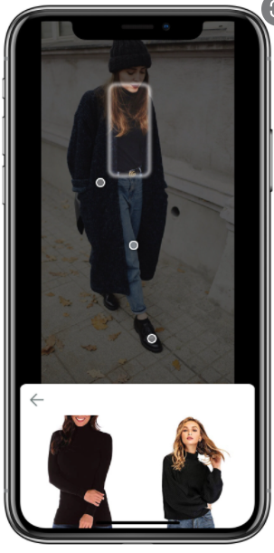
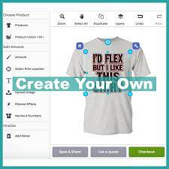
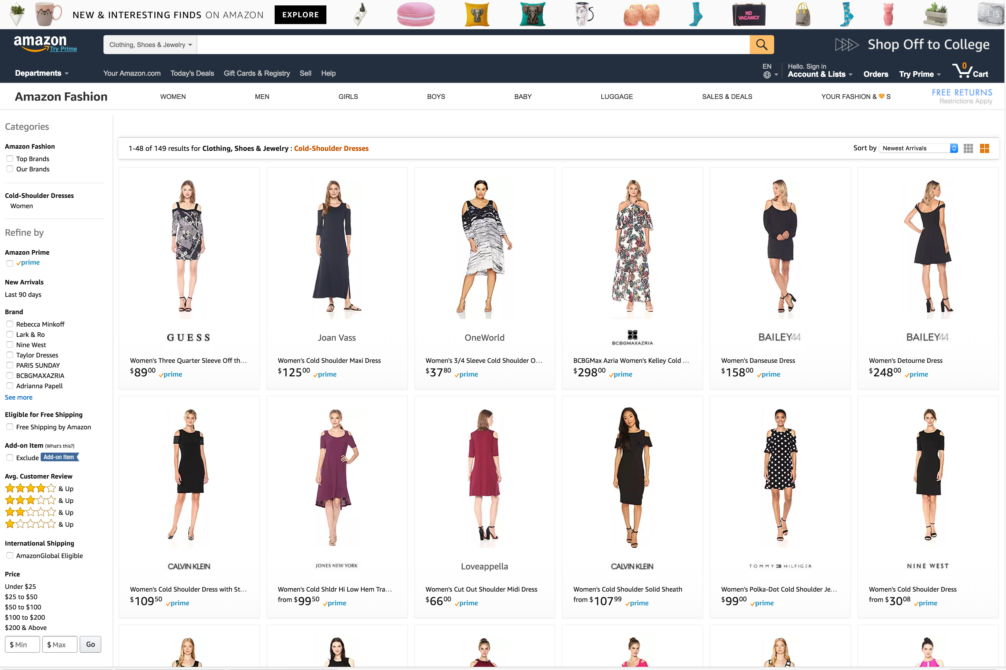
EXPERIMENTS CONDUCTED
Effort based
AI
Manual

Slide 6
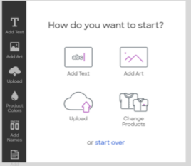

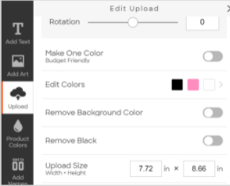
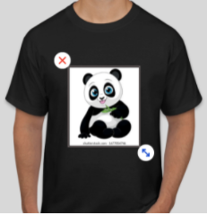
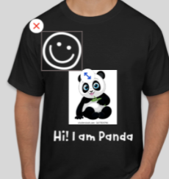
Process
Experimental Group – Effort based
Scenario: You need a t-shirt & want a custom design of your own. You can design with the help of a tool where you can choose color of T-shirt, fonts, images according to your choice and purchase it.
Created a video where we demonstrated the complete process
Circulate this videos with some questions among the respondents
Respondents watched the video and given their insights
After they finalize, we noted their willingness, their satisfaction and the easability of the process

Slide 7
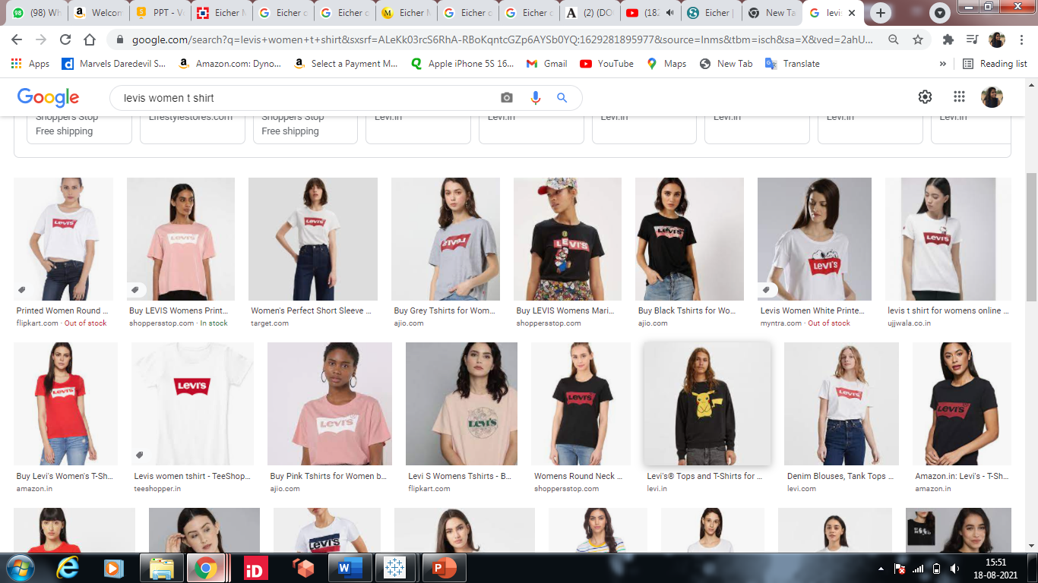

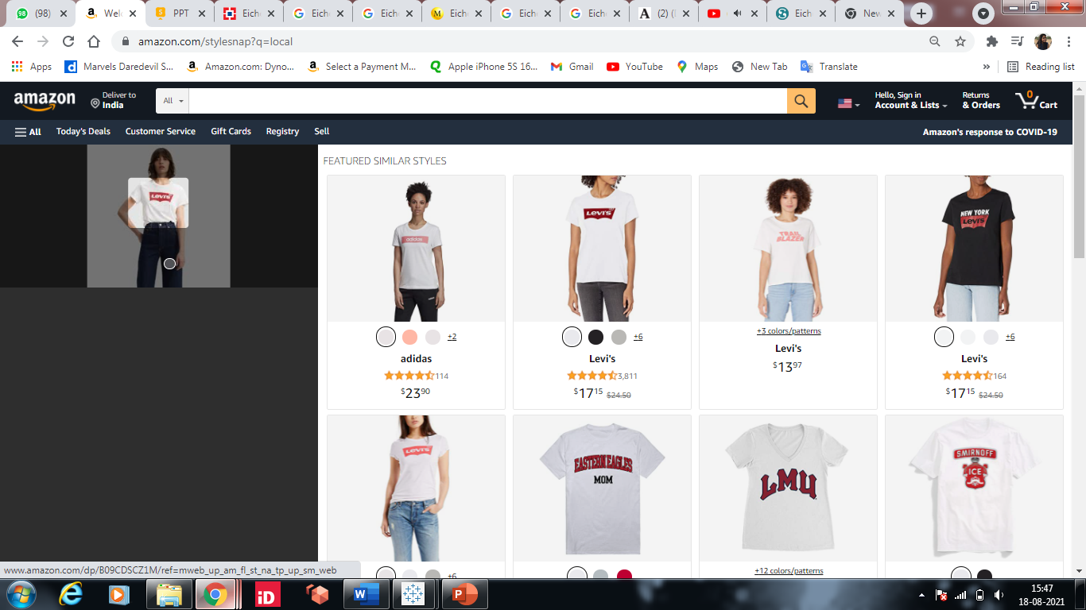
Process
Experimental Group – AI based
In this case, an AI oriented effect/stimuli is added, i.e., extra work is done by AI
Scenario: You need a t-shirt & have a specific picture which exactly depicts what you want. You upload that picture on amazon. You then, sift through the suggestions and purchase on the basis of similarity and price.
Respondents were called in a zoom call. As a replacement to their preferred choice of t-shirt, they were asked to choose one Lewis T-shirt from google
The snapshot of the selected T-shirt was then uploaded on a particular segment of Amazon which through AI then gives suggestions closely related to the preferred choice
Depending on the similarity of the product in the suggestions, the level of price and satisfaction was sought.

Slide 8
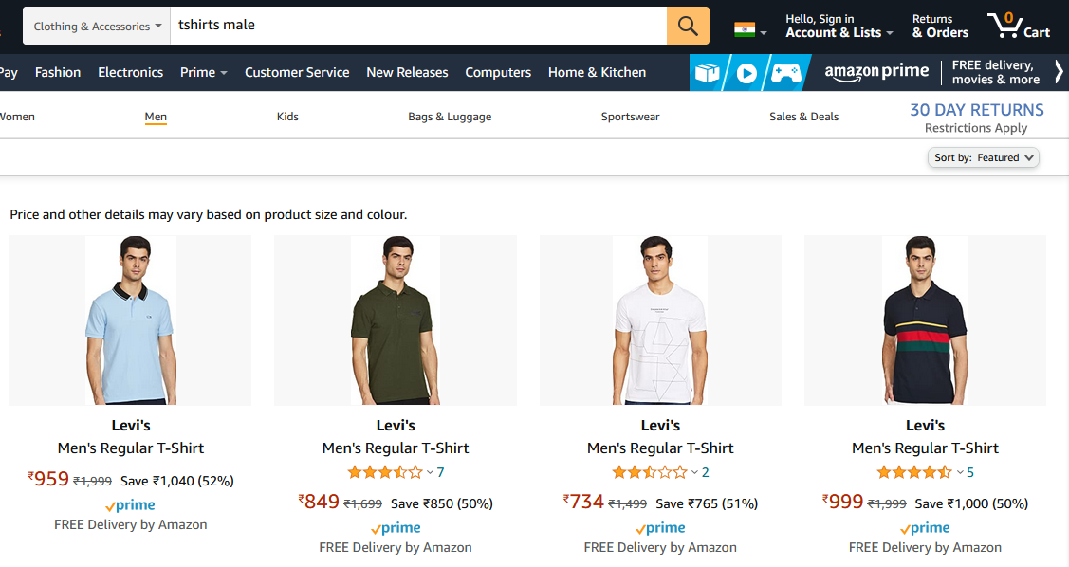
Process
CONTROL GROUP
In this case, no effect/stimuli is added, i.e., no extra labor is done by AI or by the humans
Scenario: You need a t-shirt & have very specific need in mind regarding your preferences. You sift through the clothing pieces available on the online shopping site searching and filtering options according to your needs.
Respondents first decide their preferences regarding t-shirts.
They enter keywords in the search bar to look for t-shirts and finally select the one that best suit their needs.
After they finalize a product, we noted their willingness, their satisfaction and the easability of the process.

Slide 9
Confounding Variables
Confounding Variables:
Effect of pre-displayed price on the platform.
Effect of brand and quality on the willingness to pay and satisfaction.
How were they controlled:
The price on the self design platform was hidden through ‘Inspect Element’ and modifying the HTML.
The brand and quality perception was kept constant by informing the respondents that the quality of the shirt would be on par with the brand ‘Levis’

Slide 10
Survey (Effort based v/s AI based v/s Control group)
Created a survey with comprehensive explanation of the three scenarios
The three scenarios were: 1. Do-it-yourself 2. Let AI help you 3. The traditional way
Circulated the survey amongst respondents
Analysed the results obtained
Process
Let AI help you
The traditional way
Do-it-yourself
Design your own t-shirt starting from selecting the type and color of the t-shirt to adding images, text and icons according to your choice
Upload an image of the look/style you want, get recommendations for similar items that match the look in the photo and choose the look you want
Search for what you want to buy in the search bar and then go through the various options available
(like buying from Amazon)
Limitations:
1. Explanation of the process due to online mode
2. No monitoring during the process
3. Previous experiences of the individual

Slide 11
Insights (Efforts Between)
Sample Size: 21
85%
42%
62%
4 or above rating in the Product satisfaction Score
700-900 Price Band of the Product
4 or above rating in the Process Easiness Score
Reasons for High Rating
Reasons for low rating
Getting exactly what they want
All-in-one platform
Too much effort in designing

Slide 12
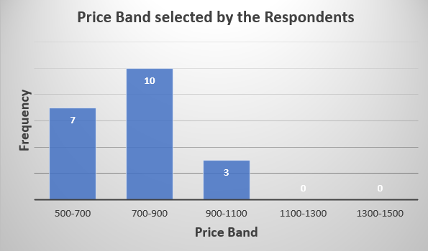
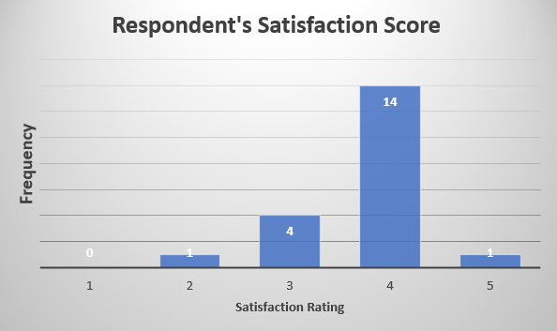
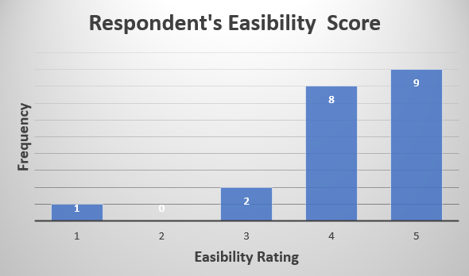
Insights (AI Between)
Sample Size: 20
75%
50%
85%
4 or above rating in the Product satisfaction Score
700-900 Price Band of the Product
4 or above rating in the Process Easiness Score
Reasons for High Rating
Reasons for low rating
Less Complex
Relevant product recommendations
Product Mismatch
Resistant to adopt new technologies
Traditional buying habits

Slide 13
Insights (Survey)
Sample Size: 20
Measures/Scenarios | Effort based | AI based | Control Group
Willingness to pay* | Rs. 800 | Rs. 850 | Rs. 760
Satisfaction (Rated greater than or equal to 4)** | 95% | 85% | 60%
Easiness of process (Rated greater than or equal to 4) ** | 85% | 95% | 50%
*For willingness to pay, average price for a particular group has been calculated (in Rs.)
**For Satisfaction and easiness of process, percentage of respondents have been measured
Conclusions :
In within-subject group, respondents –
Were the most willing to pay for AI based process
Appear be the most satisfied in effort based scenario
Found the easiest process to be that of AI based scenario

Slide 14
Recommendations
1
2
3
Customer experience should be enhanced with the use of AI when making product selection. 1. AI simplifies the process
2. AI increase customer satisfaction
3. People are willing to pay more in case of AI
For some products, allowing customers for some flexibility regarding designing, the self designing platform can be used as some customers were willing to pay a maximum price band for it.
Companies should focus on delivering great AI customer experience and focus resources on its reliability

Slide 15
ANNEXURES
Effort Based
Survey
AI Based

Slide 16

THANK YOU!

